Slide 1
Matthew 16:21-26 (NIV)
21From that time on Jesus began to explain to his disciples that he must go to Jerusalem and suffer many things at the hands of the elders, chief priests and teachers of the law, and that he must be killed and on the third day be raised to life. 22Peter took him aside and began to rebuke him. "Never, Lord!" he said. "This shall never happen to you!" 23Jesus turned and said to Peter, "Get behind me, Satan! You are a stumbling block to me; you do not have in mind the things of God, but the things of men."

Slide 2
Matthew 16:21-26 (NIV)
24Then Jesus said to his disciples, "If anyone would come after me, he must deny himself and take up his cross and follow me. 25For whoever wants to save his life will lose it, but whoever loses his life for me will find it. 26What good will it be for a man if he gains the whole world, yet forfeits his soul? Or what can a man give in exchange for his soul?

Slide 4
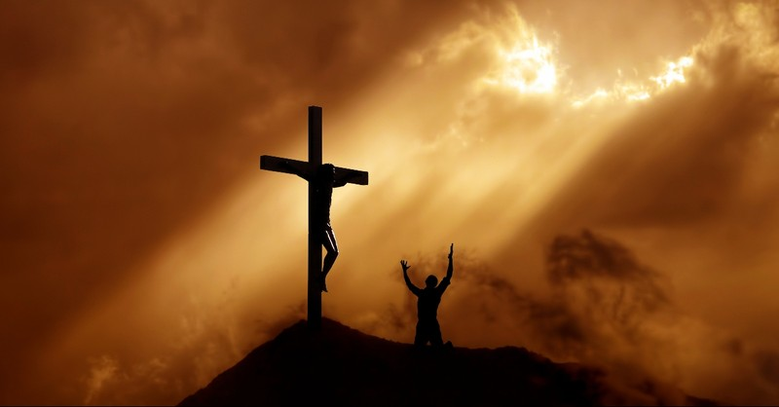

Slide 5
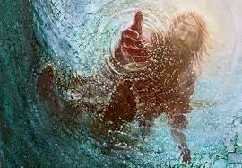

Slide 8
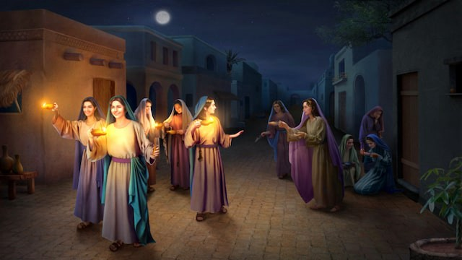

Slide 9
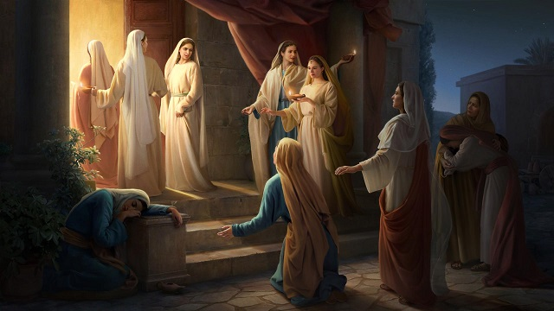

Slide 10
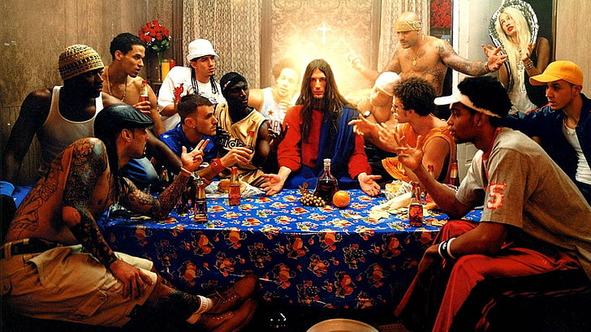

Slide 11
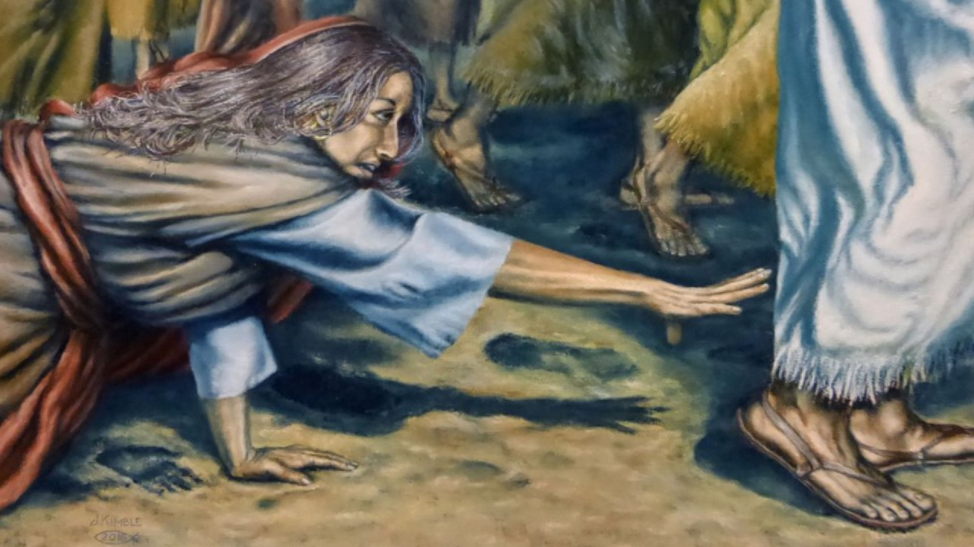

Slide 12
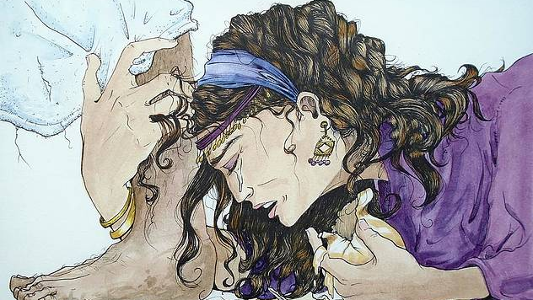

Slide 13
